Slide 1
DenseBody: Directly Regressing Dense 3D Human Pose and Shape From a Single Color Image
arXiv | 1903.10153
Pengfei Yao, Zheng Fang
Fan Wu,
Yao Feng,
Jiwei Li
Cloudwalk, Shanghai Jiao Tong University
梁天保
https://arxiv.org/abs/1903.10153

Slide 2
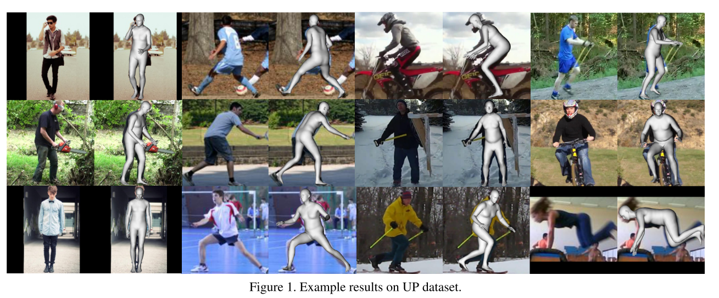
Task
https://arxiv.org/abs/1903.10153

Slide 3
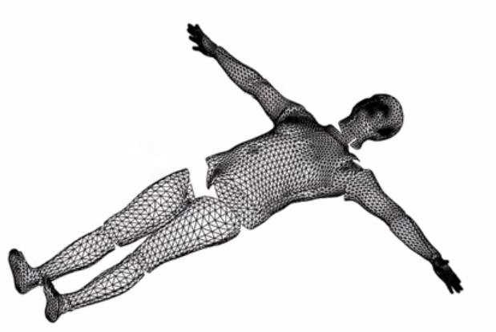
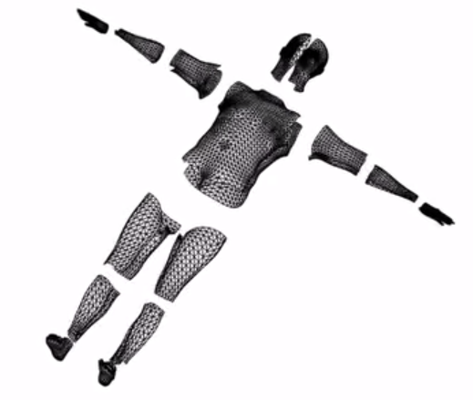
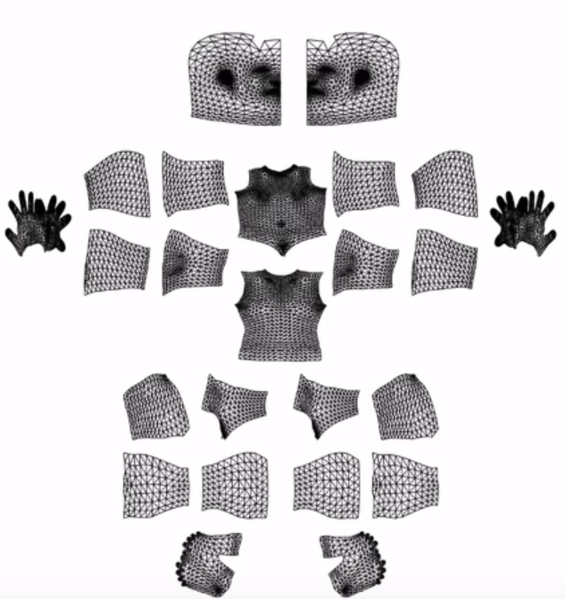
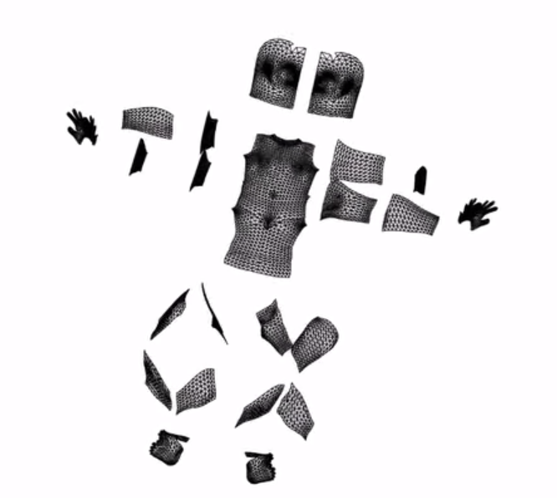
Prior Knowledge : Surface UnWrap
http://densepose.org/

Slide 4
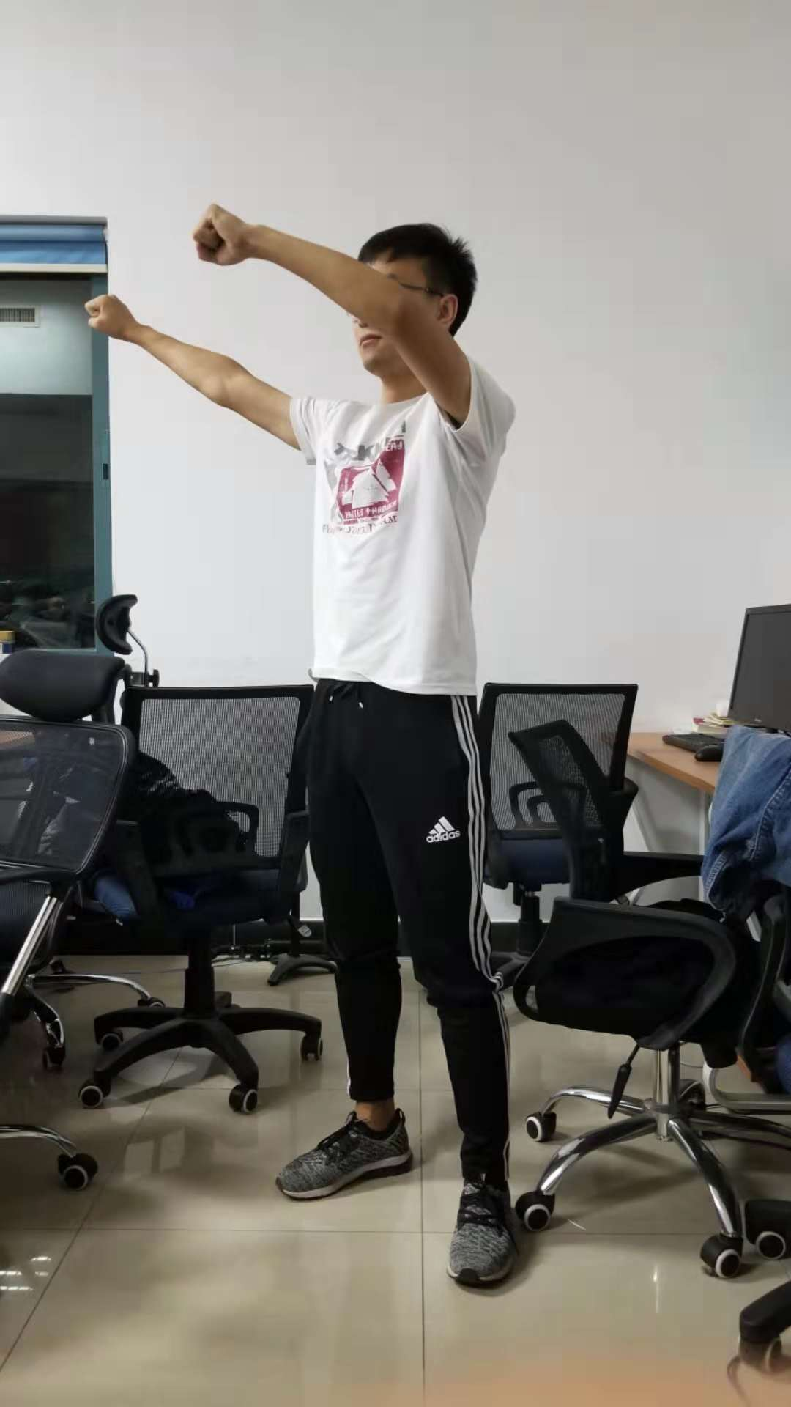
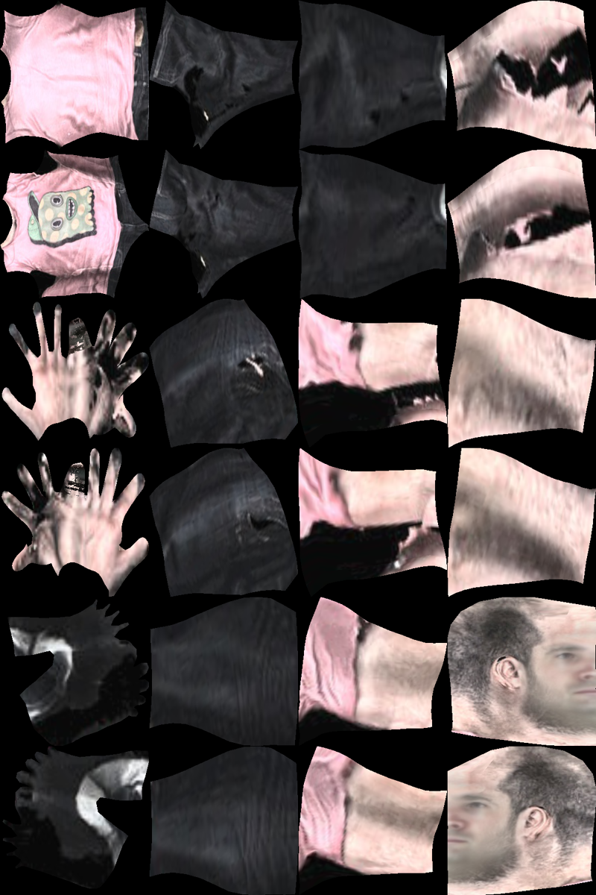
Prior Knowledge : XY & UV
Y
V
X
U
http://densepose.org/

Slide 5
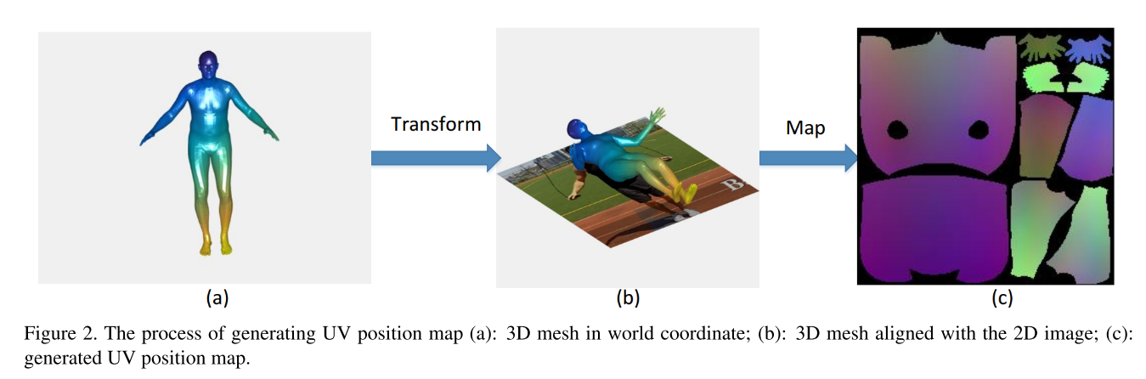
UV Position Map
https://arxiv.org/abs/1903.10153

Slide 6
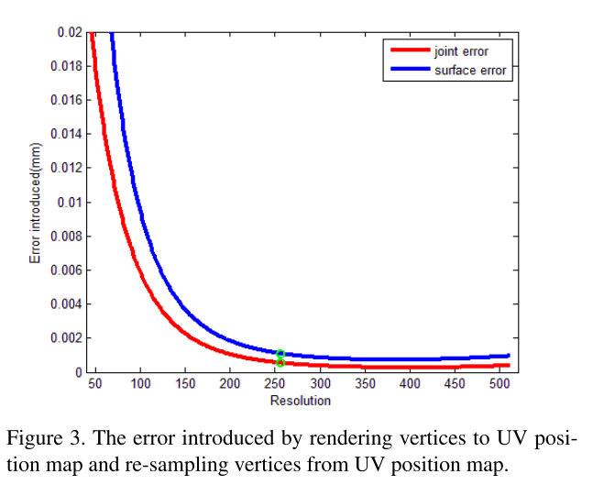
UV Representation Error
https://arxiv.org/abs/1903.10153

Slide 7
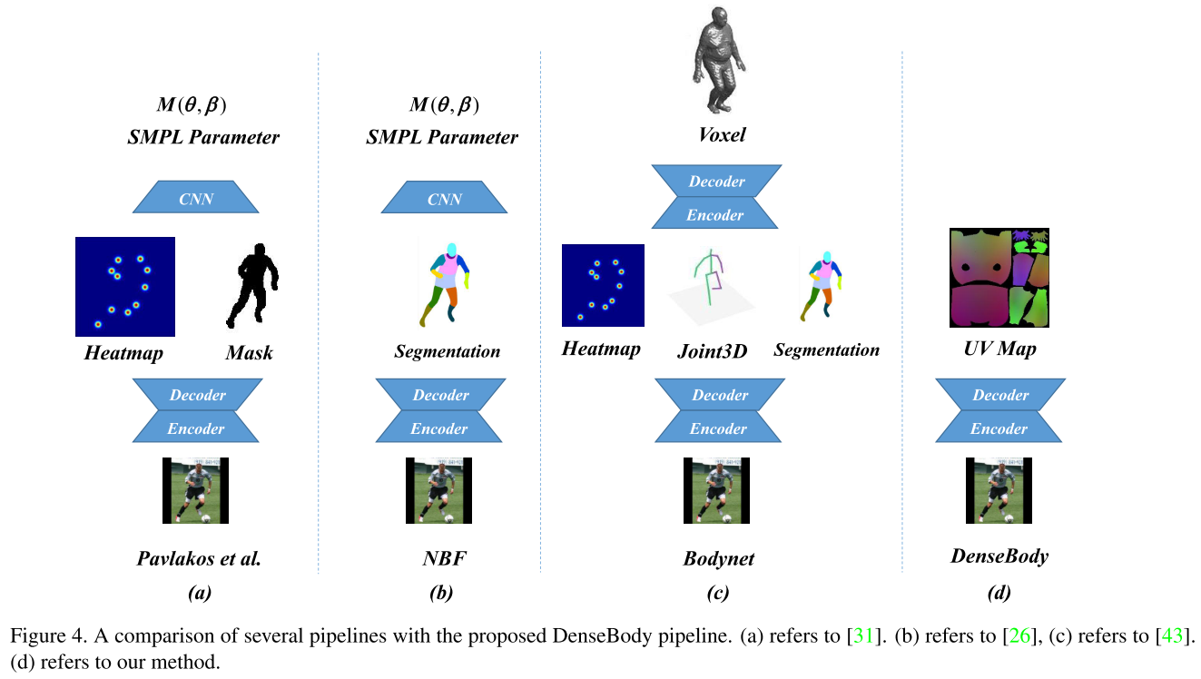
Pipeline Comparison
https://arxiv.org/abs/1903.10153

Slide 8
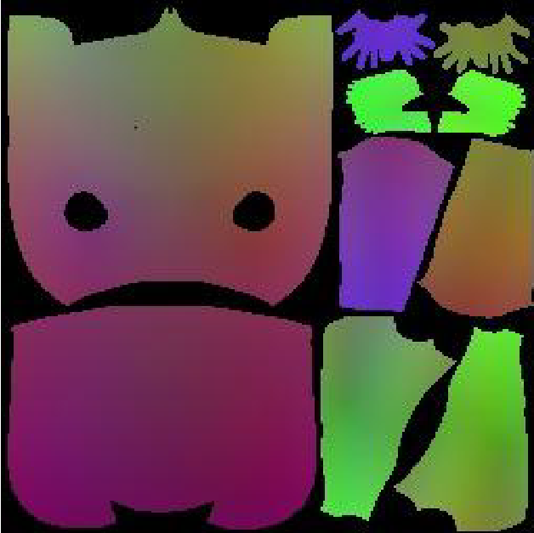
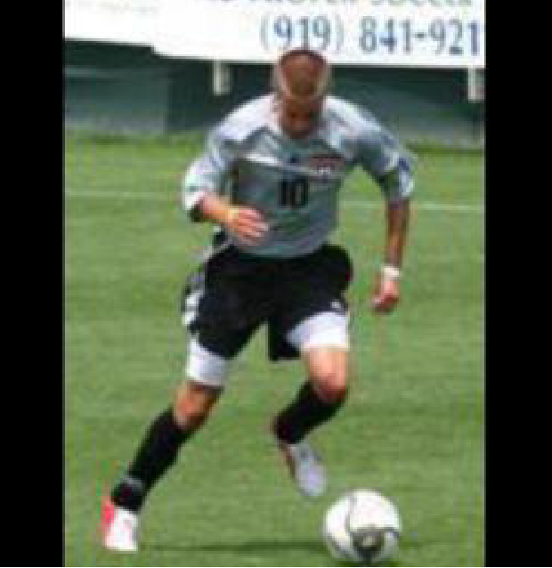
Network & Loss
Original mage
256 x 256 x 3
UV map
256 x 256 x 3
https://arxiv.org/abs/1903.10153

Slide 9
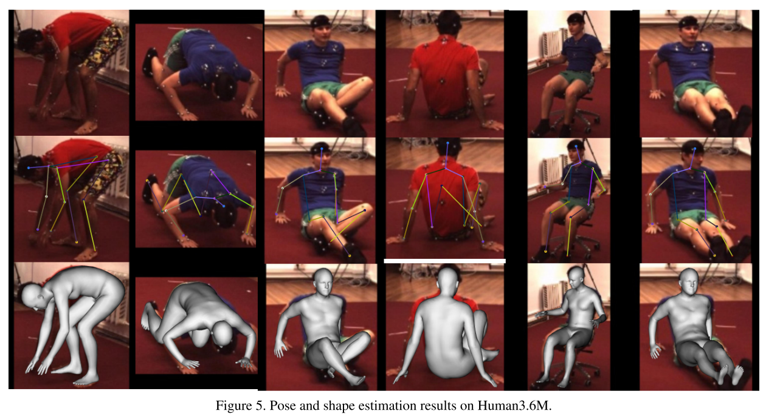
Performance
https://arxiv.org/abs/1903.10153

Slide 10
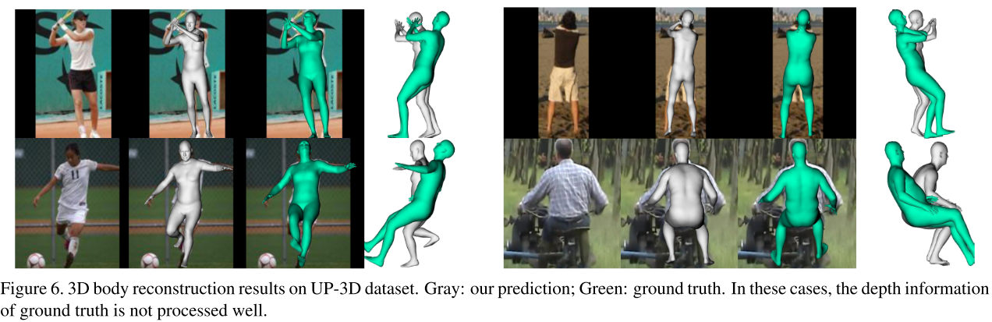
Performance
https://arxiv.org/abs/1903.10153

Slide 11
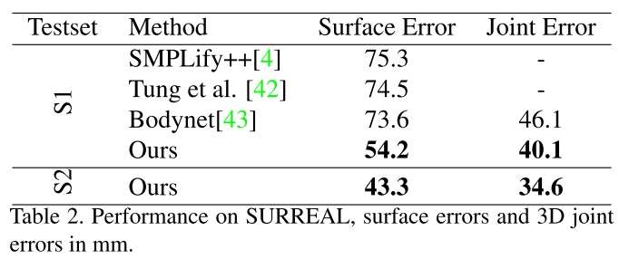
Performance
https://arxiv.org/abs/1903.10153

Slide 12
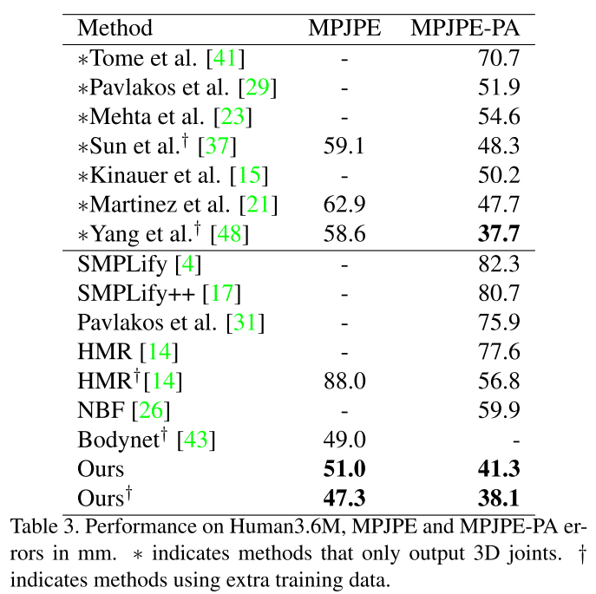
Performance
https://arxiv.org/abs/1903.10153

Slide 13
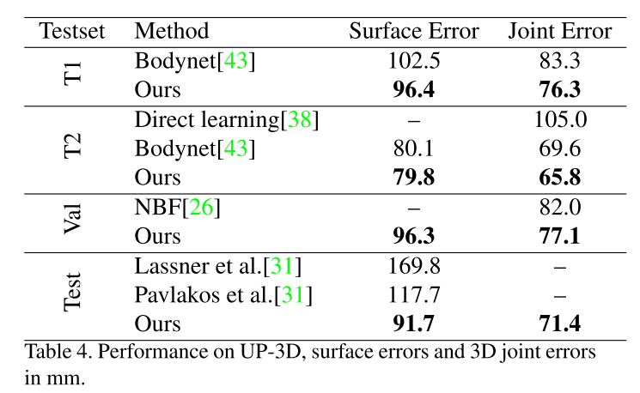
Performance
https://arxiv.org/abs/1903.10153

Slide 14
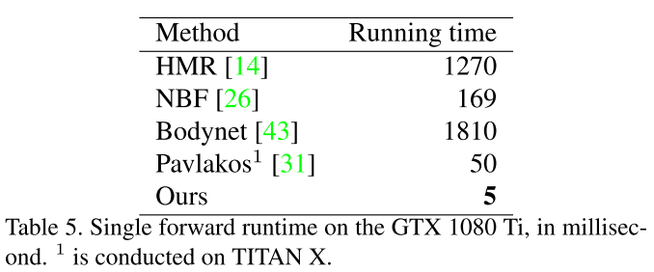
Performance
https://arxiv.org/abs/1903.10153

Slide 15
Thanks
https://arxiv.org/abs/1903.10153

